Slide 1
Event Management and
Analytical Portal
A database-driven system for college event registration, attendance, feedback and analytics
Group 15
Vennela E (Lead) 2520030288 | Jahnavi Y 2520030567 | Bhavitha 2520030120
Guide: Dr. Y Prasanthi, Assistant Professor, Dept. of CSE
Koneru Lakshmaiah Education Foundation

Slide 2
Abstract
About the project
A database-driven system that simplifies and automates the management of college events
Organizers create and manage events, venues, schedules, registrations and attendance
Students view events, register, track participation and submit feedback
Structured storage reduces duplicate records, manual work and data errors
The analytics module reports registration trends, attendance statistics, popular events and ratings
Centralized one place for all events
Accurate no duplicate records
Insightful analytics for planning
2

Slide 3
Problem and Proposed Solution
Existing system: the problem
Proposed solution
Events handled through forms, spreadsheets and chat groups
Duplicate and inconsistent registration records
Manual attendance that is slow and error-prone
Feedback scattered and hard to analyse
No insight into popular events or participation trends
One centralized portal for students, organizers and admins
Online registration with duplicate prevention
Attendance tracked against each registration
Ratings and comments collected after every event
Analytics on registrations, attendance and ratings
3

Slide 4
Objectives and Modules
Goal: centralize event management, reduce manual work and duplicate data, and help organizers decide using data.
User Management
Event Management
Registration
Students, organizers and admins with role-based login
Create, update and delete events; date, time, venue, category
Students register online; organizers track registrations
Attendance
Feedback
Analytics & Reports
Record check-in and track participation per event
Ratings and comments to measure satisfaction
Trends in registrations, attendance and ratings
4

Slide 5
Users and Roles
Administrator
Organizer
Student
Manages users and roles
Oversees all events and venues
Views overall reports
Maintains data quality
Creates and updates events
Sets date, time, venue, category
Tracks registrations
Records attendance and reads feedback
Browses upcoming events
Registers online
Tracks own participation
Submits rating and comments
5

Slide 6
System Architecture
Presentation layer
HTML, CSS, JavaScript, Chart.js
Application layer
Java, Spring Boot REST APIs
Data layer
MySQL database
Event listing and registration pages
Attendance and feedback forms
Charts for analytics
Business rules and validation
Login and role-based access
Tested with Postman
8 related tables with keys
Views for reports
Procedures and triggers
6

Slide 7
Event Workflow
1
2
3
4
5
Create event
Register
Attend
Feedback
Analyse
Organizer sets date, venue, category and seat limit
Student registers online for an upcoming event
Check-in is recorded against the registration
Student rates the event and adds comments
Reports show trends, attendance and ratings
Data rules: no duplicate registration, seat limit respected, attendance linked to a registration, rating within a fixed scale
7

Slide 8
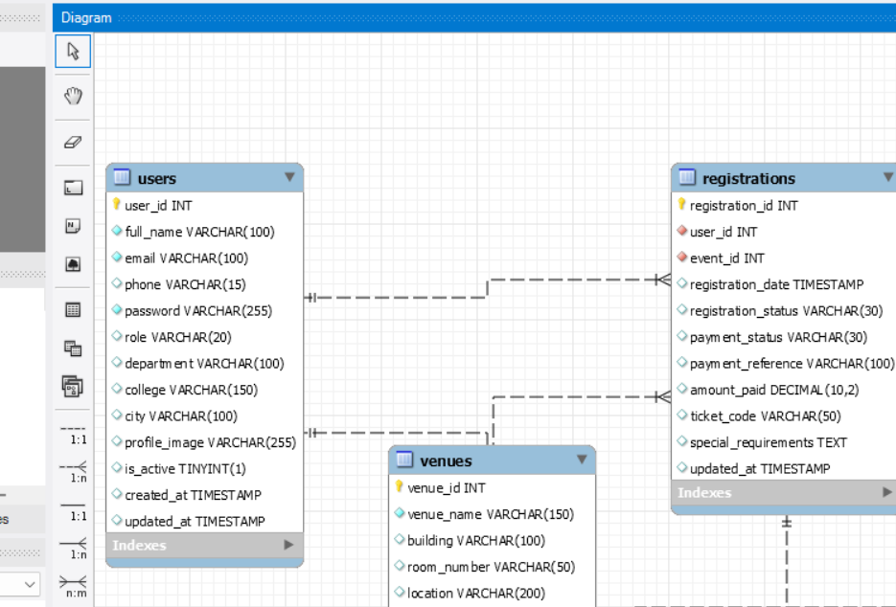
ER Diagram (1 of 2): Users and Registrations
Key links
users: students and organizers log in with a role
registrations.user_id references users
registrations.event_id references events
Registration also stores payment status and ticket code
venues and organizers are separate tables linked to events
8

Slide 9
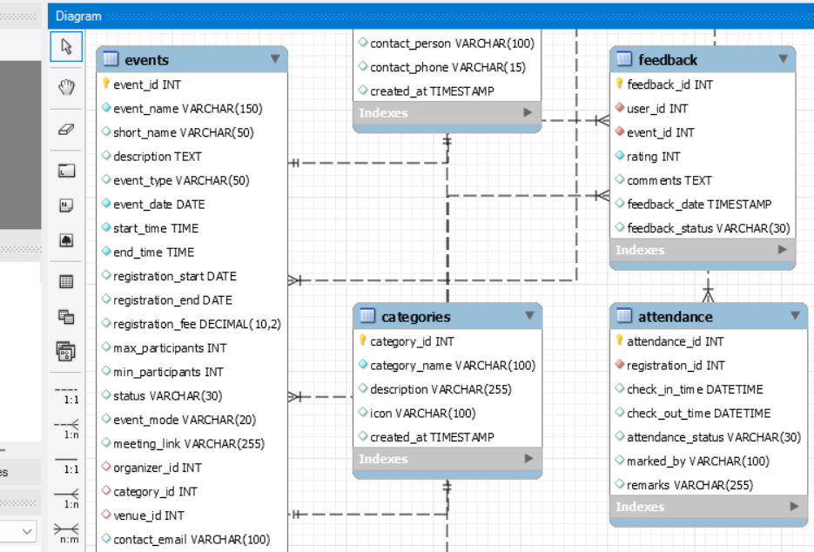
ER Diagram (2 of 2): Events, Feedback, Attendance
Key links
events holds organizer_id, category_id and venue_id
categories classify many events
attendance.registration_id references registrations
Check-in and check-out time recorded
feedback.user_id and event_id link rating to a user and event
9

Slide 10
Tables and Key Columns
Table | Key columns | Foreign keys
users | user_id (PK), full_name, email, phone, role, department, college | -
organizers | organizer_id (PK), organizer_name, email, organization, designation | -
venues | venue_id (PK), venue_name, building, room_number, capacity, venue_type | -
categories | category_id (PK), category_name, description | -
events | event_id (PK), event_name, event_type, event_date, times, fee, max_participants, status | organizer_id, category_id, venue_id
registrations | registration_id (PK), registration_date, registration_status, payment_status, ticket_code | user_id, event_id
attendance | attendance_id (PK), check_in_time, check_out_time, attendance_status | registration_id
feedback | feedback_id (PK), rating, comments, feedback_date | user_id, event_id
10

Slide 11
Database Design and Analytics
8 core tables
Analytical output
users, organizers, venues, categories
events (organizer, category and venue as foreign keys)
registrations (user and event)
attendance (registration)
feedback (user, event, rating 1-5)
Keys and constraints prevent duplicate and orphan records
JOIN, GROUP BY, HAVING and aggregate queries
Registration trends and most popular events
Attendance percentage and no-show analysis
Average rating by event and category
Views for dashboards; stored procedures and triggers for rules like event-full checks
11

Slide 12
Normalization and Integrity
Normalization (up to 3NF)
Integrity and automation
1NF: every column holds one value; each table has a primary key
2NF: registration details depend on the whole registration, not on user or event alone
3NF: venue, category and organizer details are stored once and referenced by ID
Attendance and feedback kept separate from registration
Primary and foreign keys link every record
Unique email; rating limited to a valid range
Triggers can enforce seat limits and attendance rules
Views give ready-made reports
Stored procedures wrap register, cancel and report actions
12

Slide 13
Sample Analytical Queries
Most popular events
SELECT e.event_name, COUNT(r.registration_id) AS total
FROM events e JOIN registrations r ON r.event_id = e.event_id
GROUP BY e.event_id, e.event_name ORDER BY total DESC;
Attendance percentage
SELECT e.event_name,
ROUND(100*SUM(a.attendance_status='Present')/COUNT(*),1) AS attendance_pct
FROM attendance a JOIN registrations r ON r.registration_id = a.registration_id
JOIN events e ON e.event_id = r.event_id GROUP BY e.event_id, e.event_name;
Top-rated events
SELECT e.event_name, ROUND(AVG(f.rating),2) AS avg_rating
FROM feedback f JOIN events e ON e.event_id = f.event_id
GROUP BY e.event_id, e.event_name HAVING COUNT(*) >= 3
ORDER BY avg_rating DESC;
13

Slide 14
Technology, Conclusion and Future Scope
Technology
Conclusion
Future scope
Frontend: HTML, CSS, JavaScript
Backend: Java, Spring Boot (JDK 17+)
Database: MySQL, Workbench
Charts: Chart.js
Tools: Postman, Git and GitHub
Centralized, organized event management
Less manual work and fewer data errors
Analytics support better planning
Mobile app
QR code attendance
Email / SMS reminders
Real-time dashboards
AI event recommendations
Online certificates
14

Slide 15
Thank You
Questions?
Vennela E | Jahnavi Y | Bhavitha (Group 15)

